Slide 1
Ant Colony Optimization

Slide 2
Outline
Introduction to TSP
Natural behavior of ants
First Algorithm: Ant System
Improvements to Ant System
Applications

Slide 3
The Traveling Salesman Problem
Given:
Set of cities {c₁,c₂,…,c_{N} }.
For each pair of cities {c_{i},c_{j}}, a distance d(c_{i},c_{j}).
Find:
Permutation that minimizes

Slide 4
History of TSP
1800’s: Irish Mathematician, Sir William Rowan Hamilton
1930’s: Studied by Mathematicians Menger, Whitney, Flood etc.
1954: Dantzig, Fulkerson, Johnson, 49 cities (capitals of USA states) problem solved
1971: 64 Cities
1975: 100 Cities
1977: 120 Cities
1980: 318 Cities
1987: 666 Cities, 2392 Cities (in printed circuit board)
1994: 7397 Cities
1998: 13509 Cities (all towns in the USA with population > 500)
2001: 15112 Cities (towns in Germany)
2004: 24978 Cities (places in Sweden)
2006: 85,900 Locations in a VLSI Application
2012: The Concorde TSP solver is now available for the iPhone and iPad

Slide 5
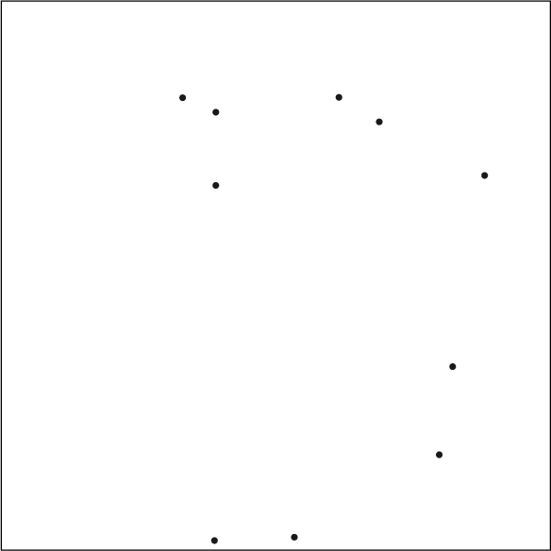
N = 10

Slide 6
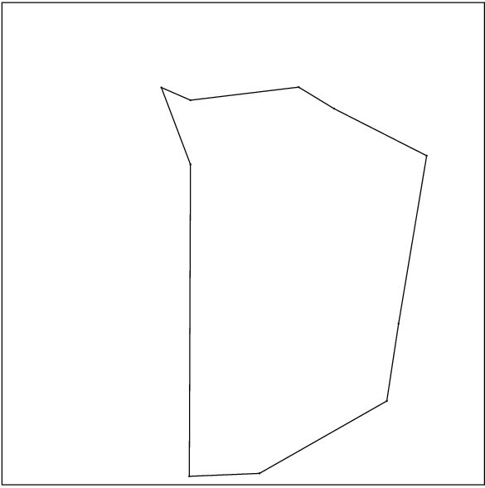
N = 10

Slide 7
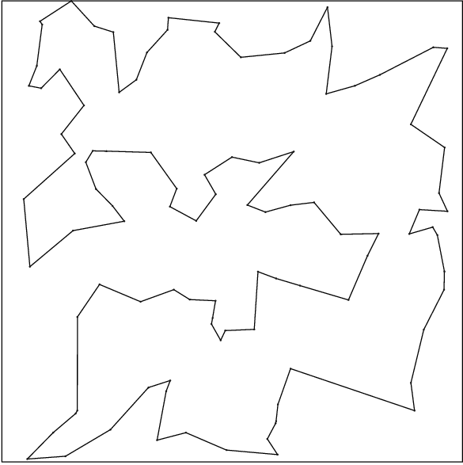
N = 100

Slide 8
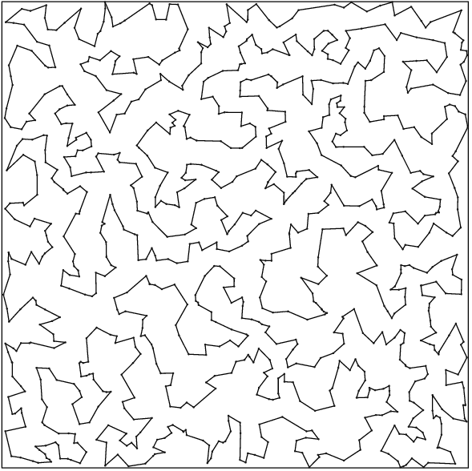
N = 1,000

Slide 9
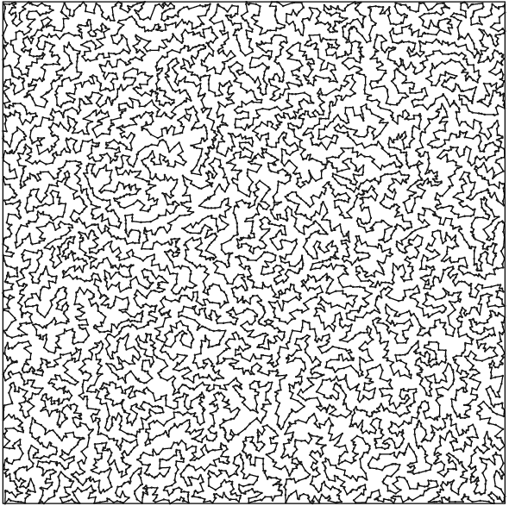
N = 10,000

Slide 10
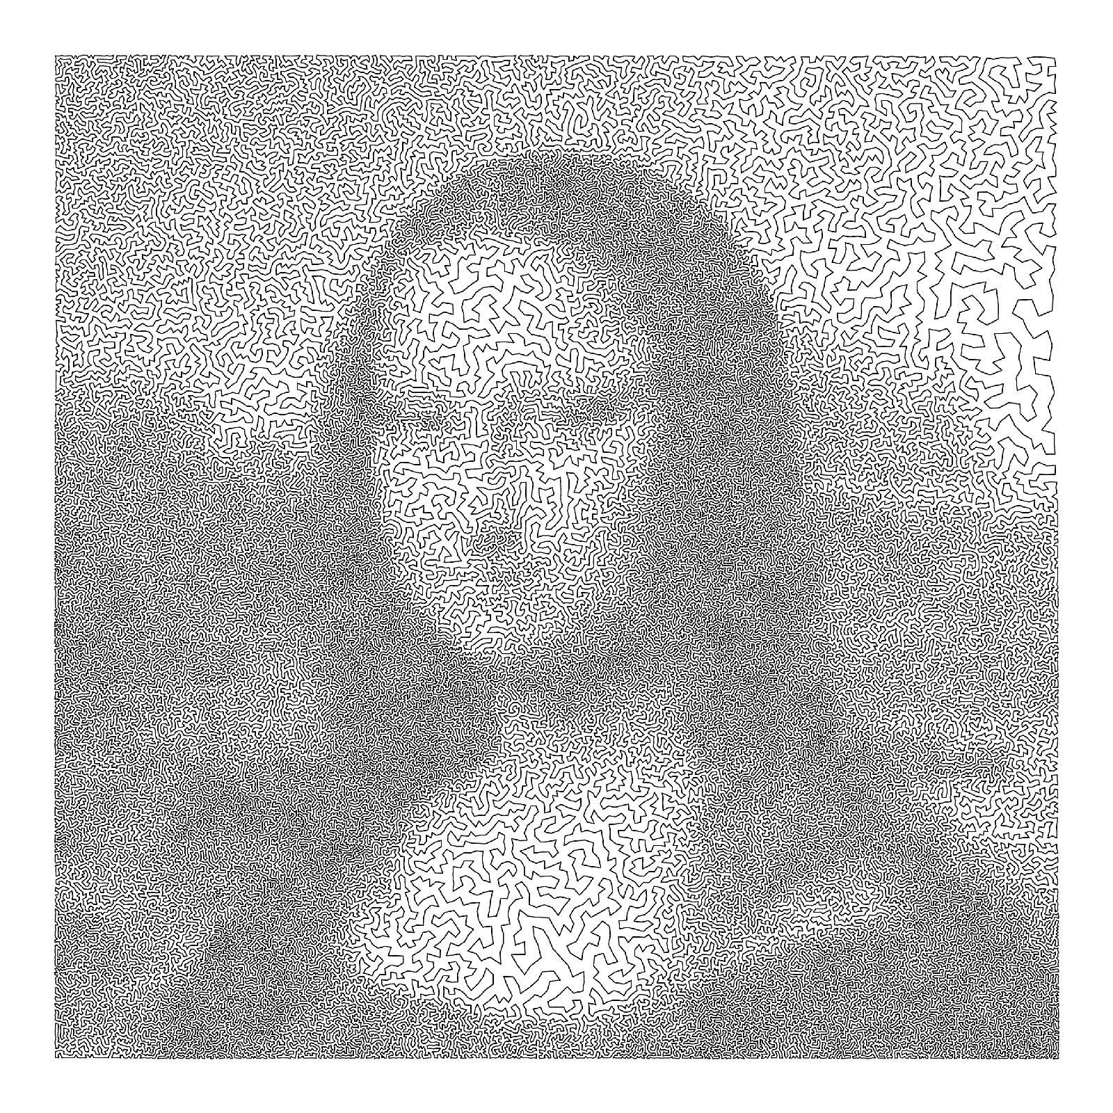
N = 100,000

Slide 11
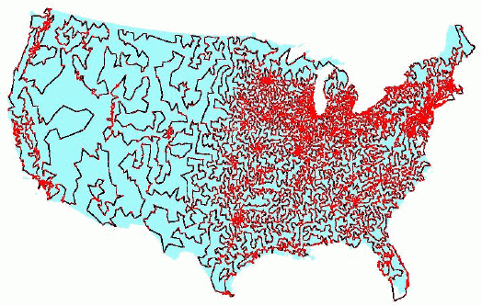

Slide 12
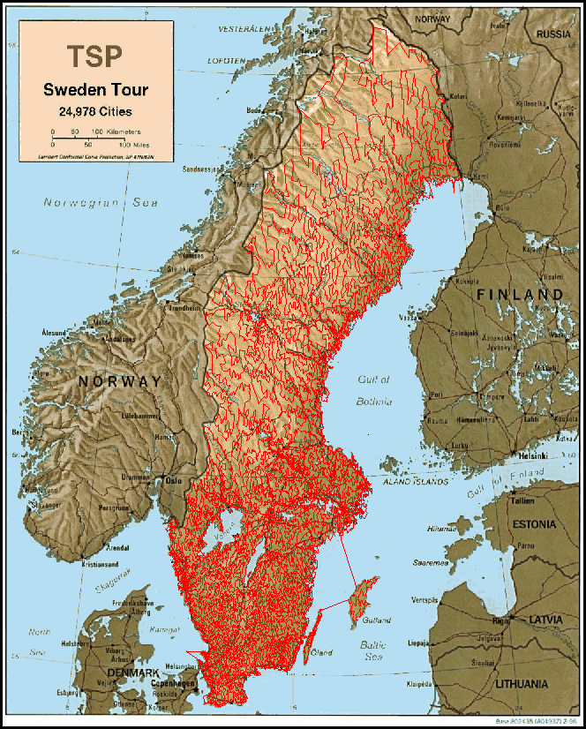

Slide 13
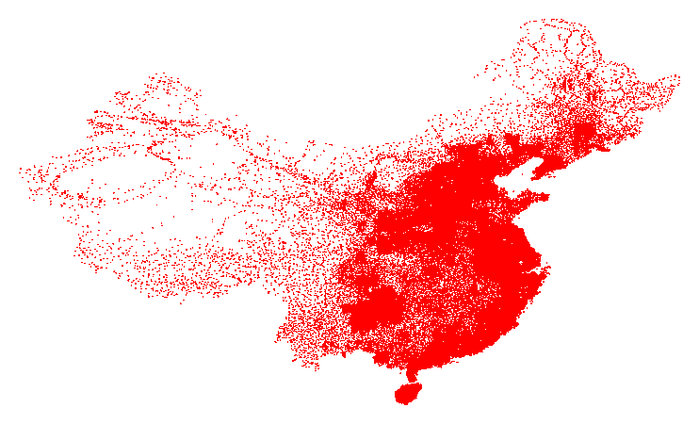
71,009 Cities in China, derived from data from the National Imagery and Mapping Agency database of geographic feature names.

Slide 14
Application #1
Cities:
Holes to be drilled in printed circuit boards

Slide 15
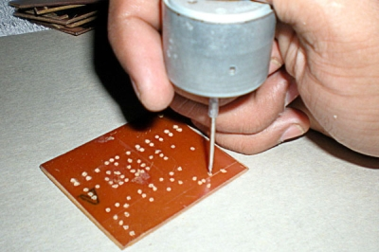

Slide 16
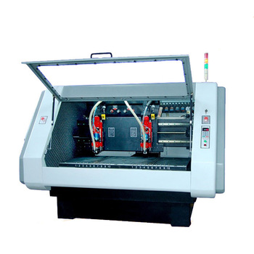

Slide 17
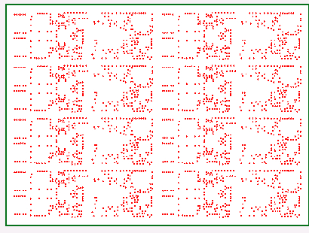
N = 2392

Slide 18
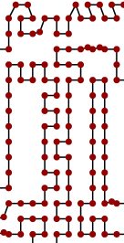
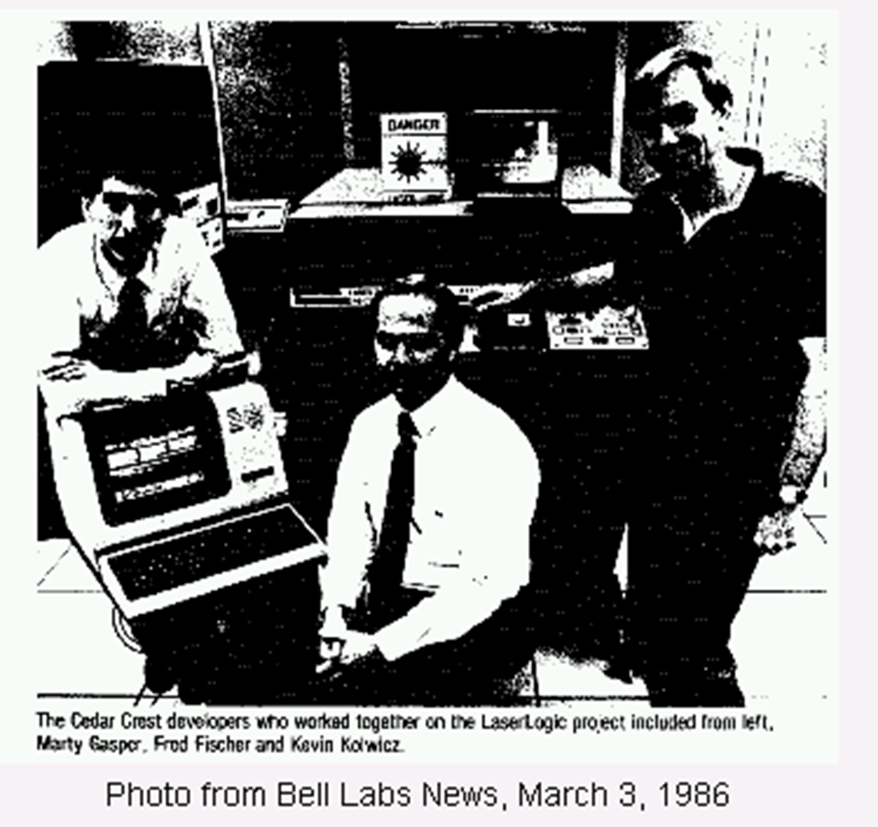
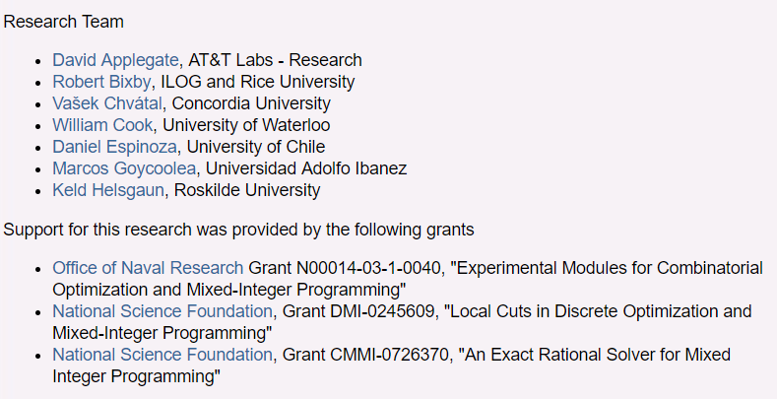
Application #2
Wires to be cut in a “Laser Logic” chip
The 15-year race for shorter tours
贝尔实验室：晶体管、激光器、太阳能电池、发光二极管、数字交换机、通信卫星、电子数字计算机、蜂窝移动通信设备、长途电视传送、仿真语言、有声电影、立体声录音，以及通信网
TSPLIB collection: pla7397, pla33810, and pla85900;
http://www.math.uwaterloo.ca/tsp/index.html

Slide 19
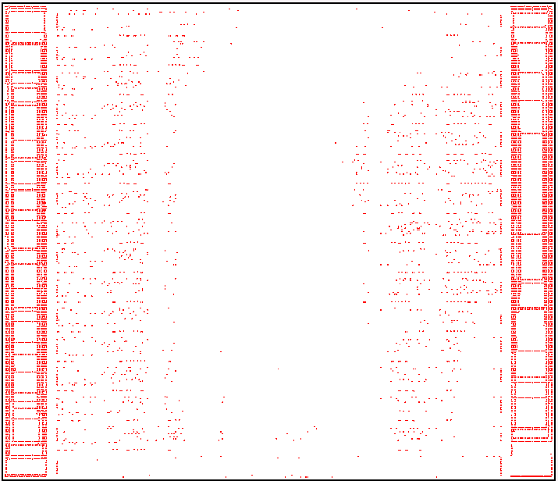
N = 7397

Slide 20
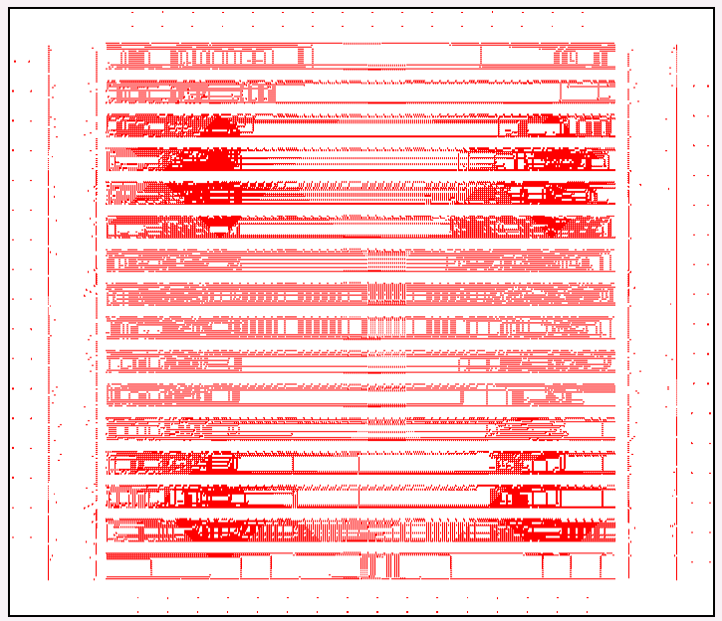
N = 33,810

Slide 21
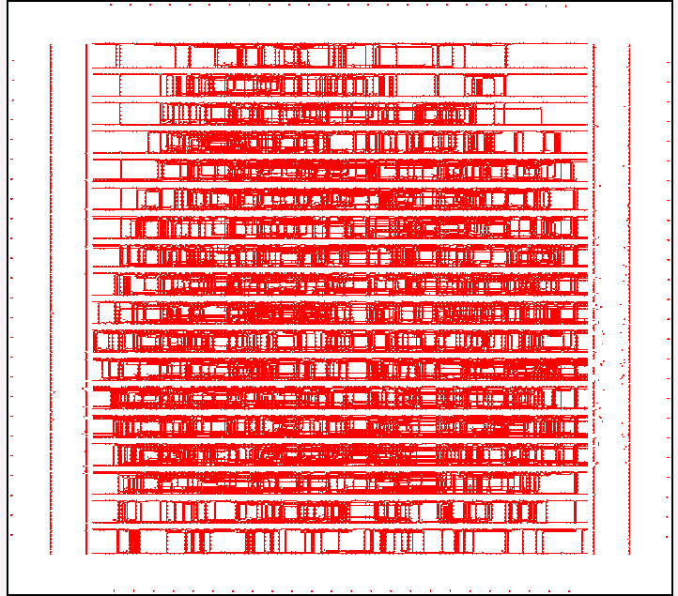
N = 85,900

Slide 22
Other Types of Instances
X-ray crystallography
Cities: orientations of a crystal
Distances: time for motors to rotate the crystal from one orientation to the other
High-definition video compression
Cities: binary vectors of length 64 identifying the summands for a particular function
Distances: Hamming distance (the number of terms that need to be added/subtracted to get the next sum)
Notes:
X射线晶体学

Slide 23
Other Types of Instances
Routing around Cities
Computer Wiring - connecting together computer components using minimum wire length
Archaeological Seriation - ordering sites in time
Genome Sequencing - arranging DNA fragments in sequence
Job Sequencing - sequencing jobs in order to minimise total set-up time between jobs
Wallpapering to Minimise Waste
NB: First three applications generally symmetric
Last three asymmetric

Slide 24
Major Practical Extension of the TSP
Vehicle Routing - Meet customers demands within given time windows using lorries of limited capacity
10am-1pm
7am-8am
3am-5am
4pm-7pm
6pm-7pm
Depot
8am-10am
6am-9am
2pm-3pm
Much more difficult than TSP

Slide 25
Key Fact about the TSP
It is NP-Complete.

Slide 26
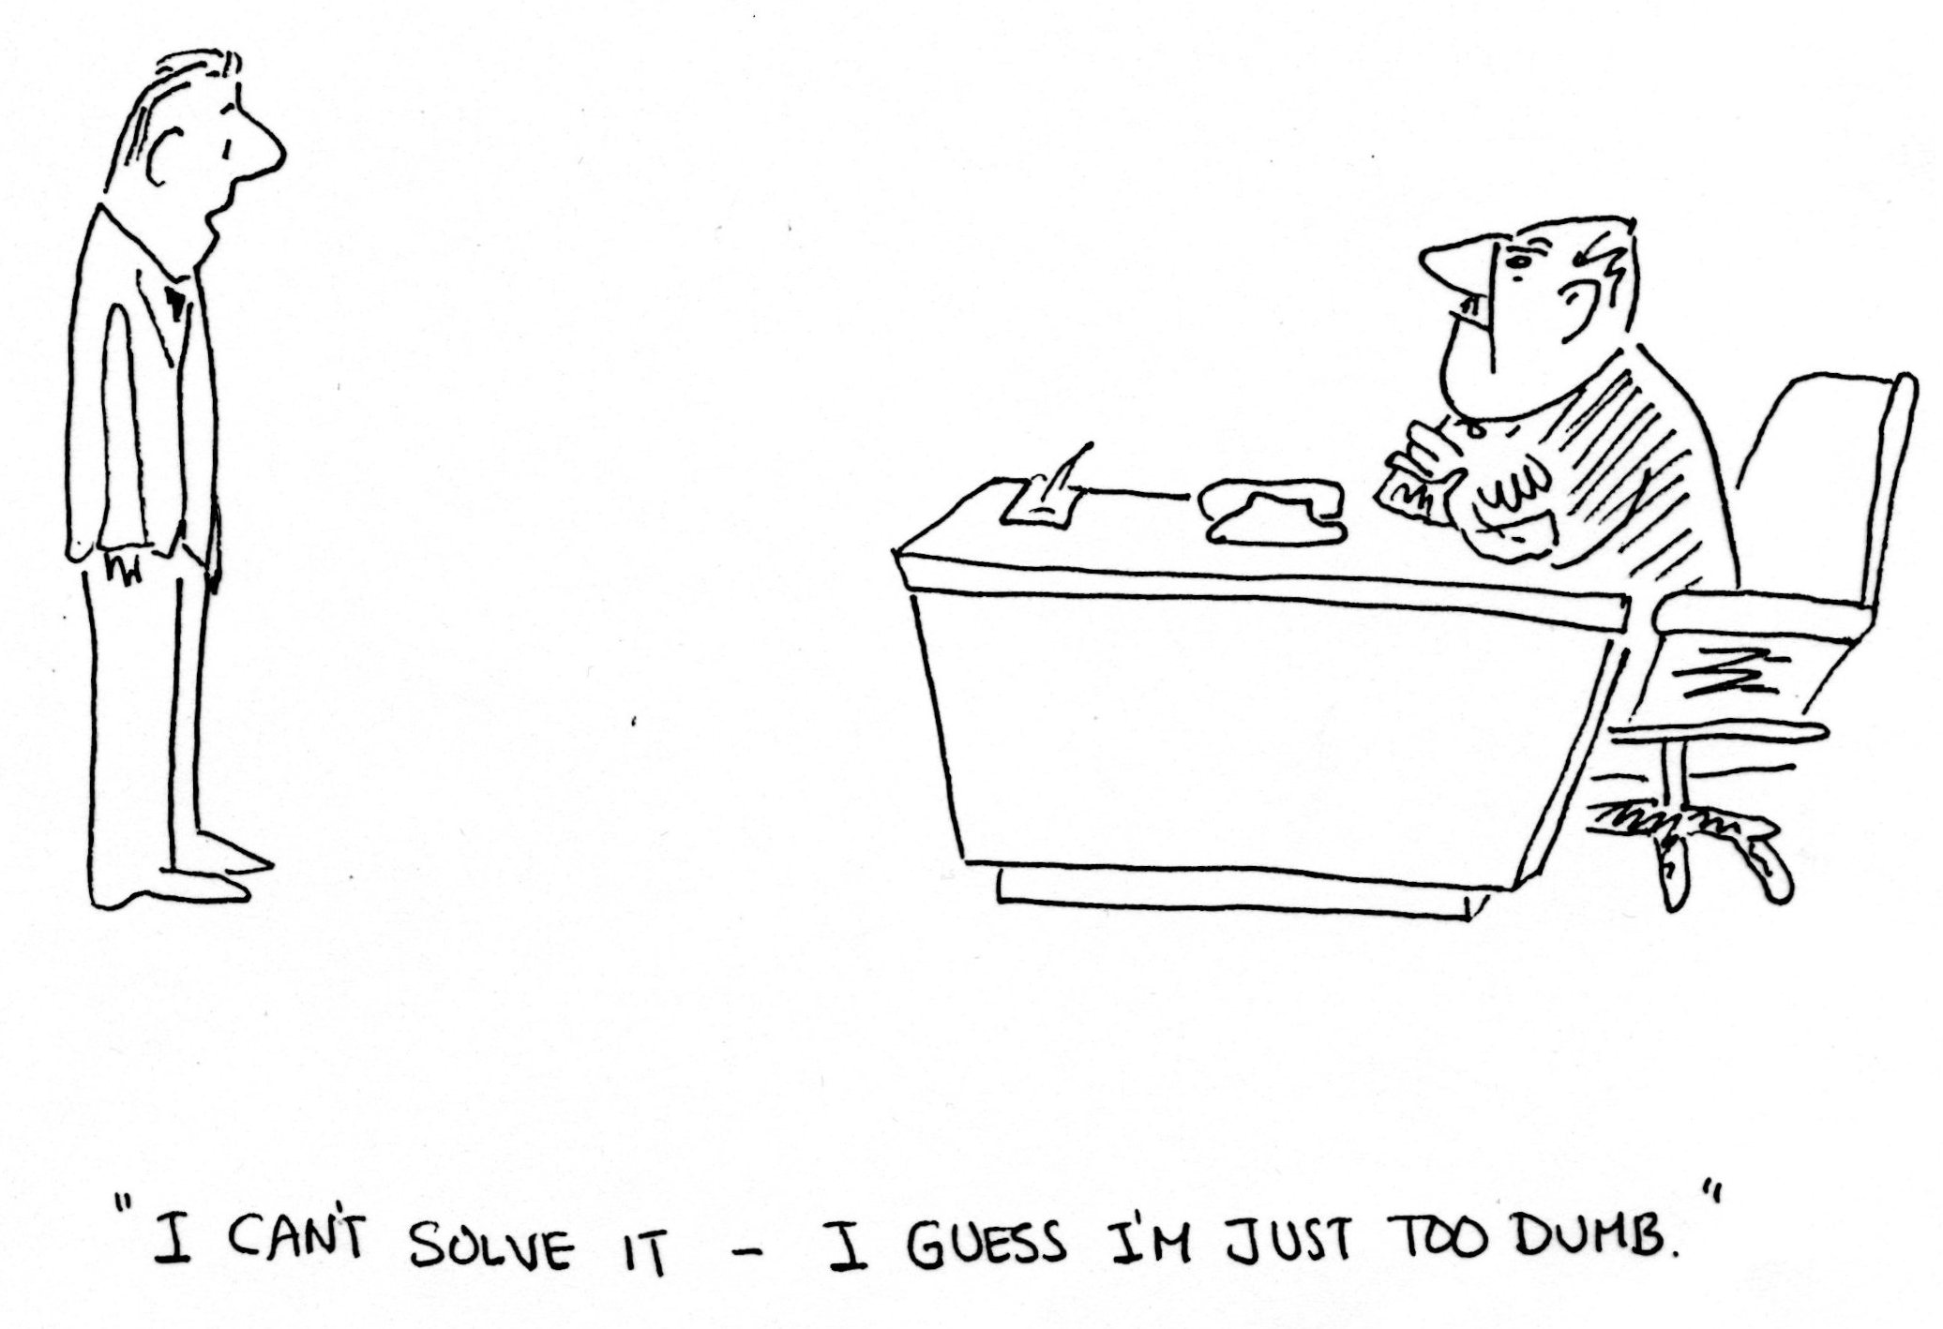

Slide 27
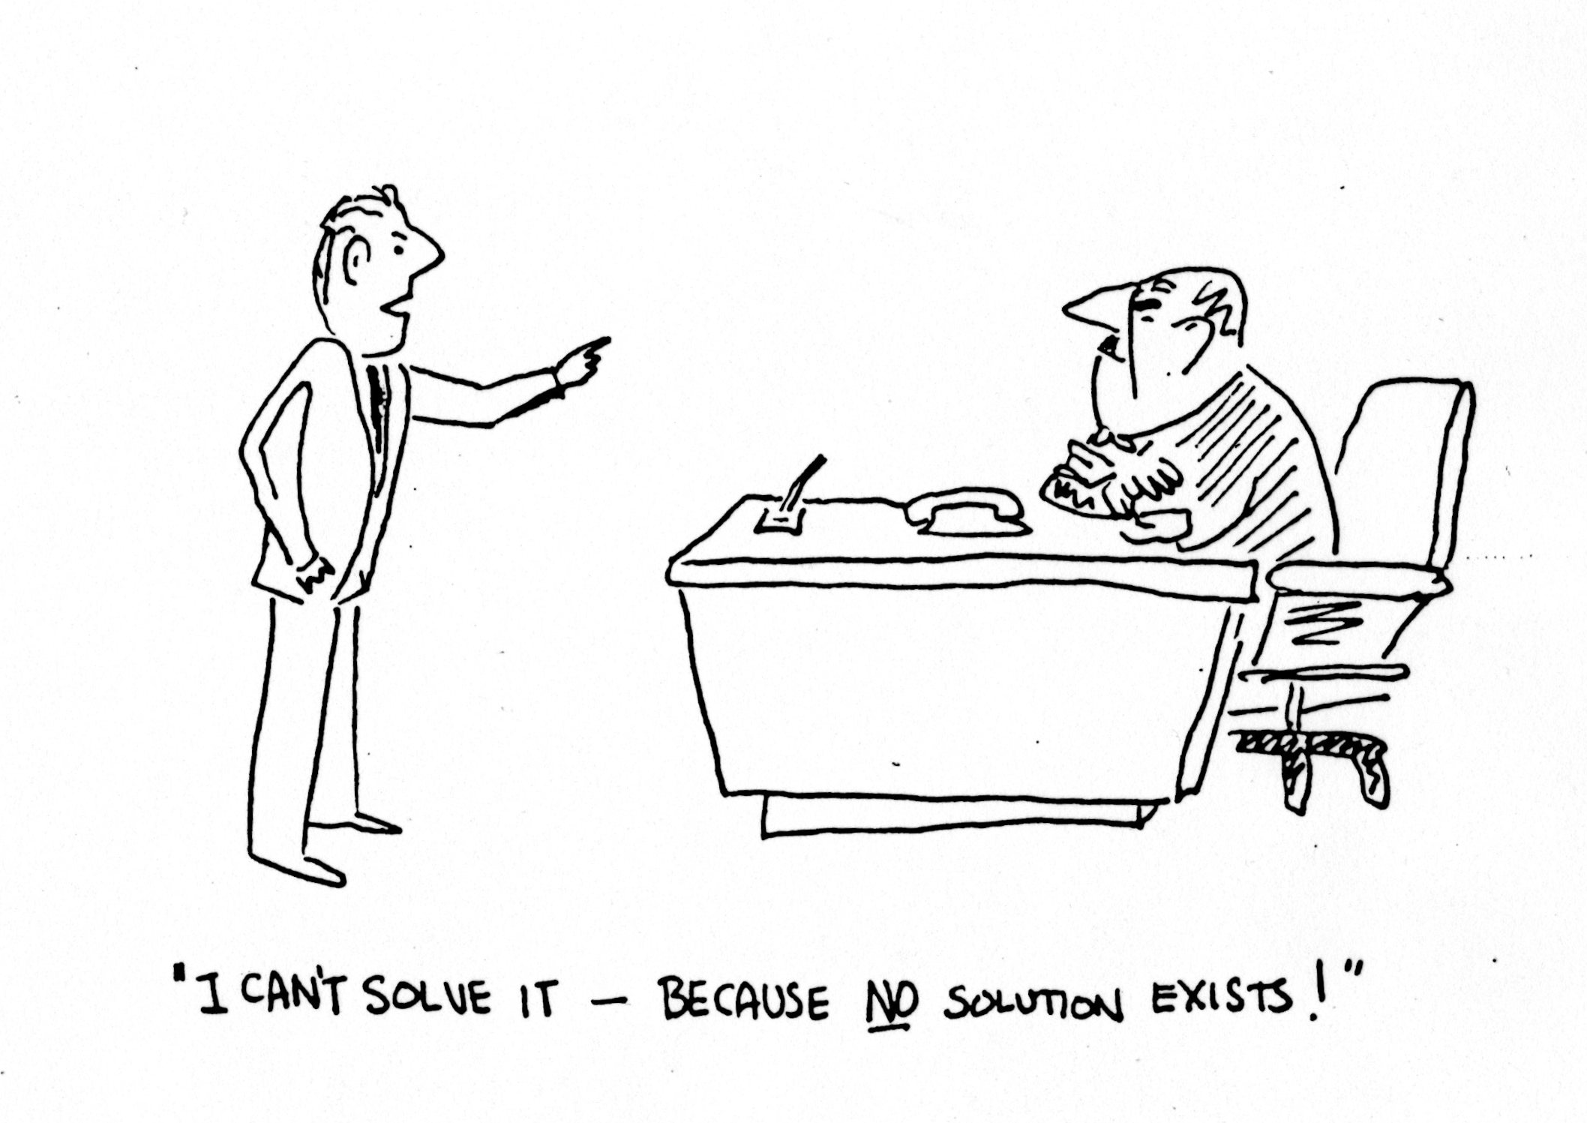

Slide 28
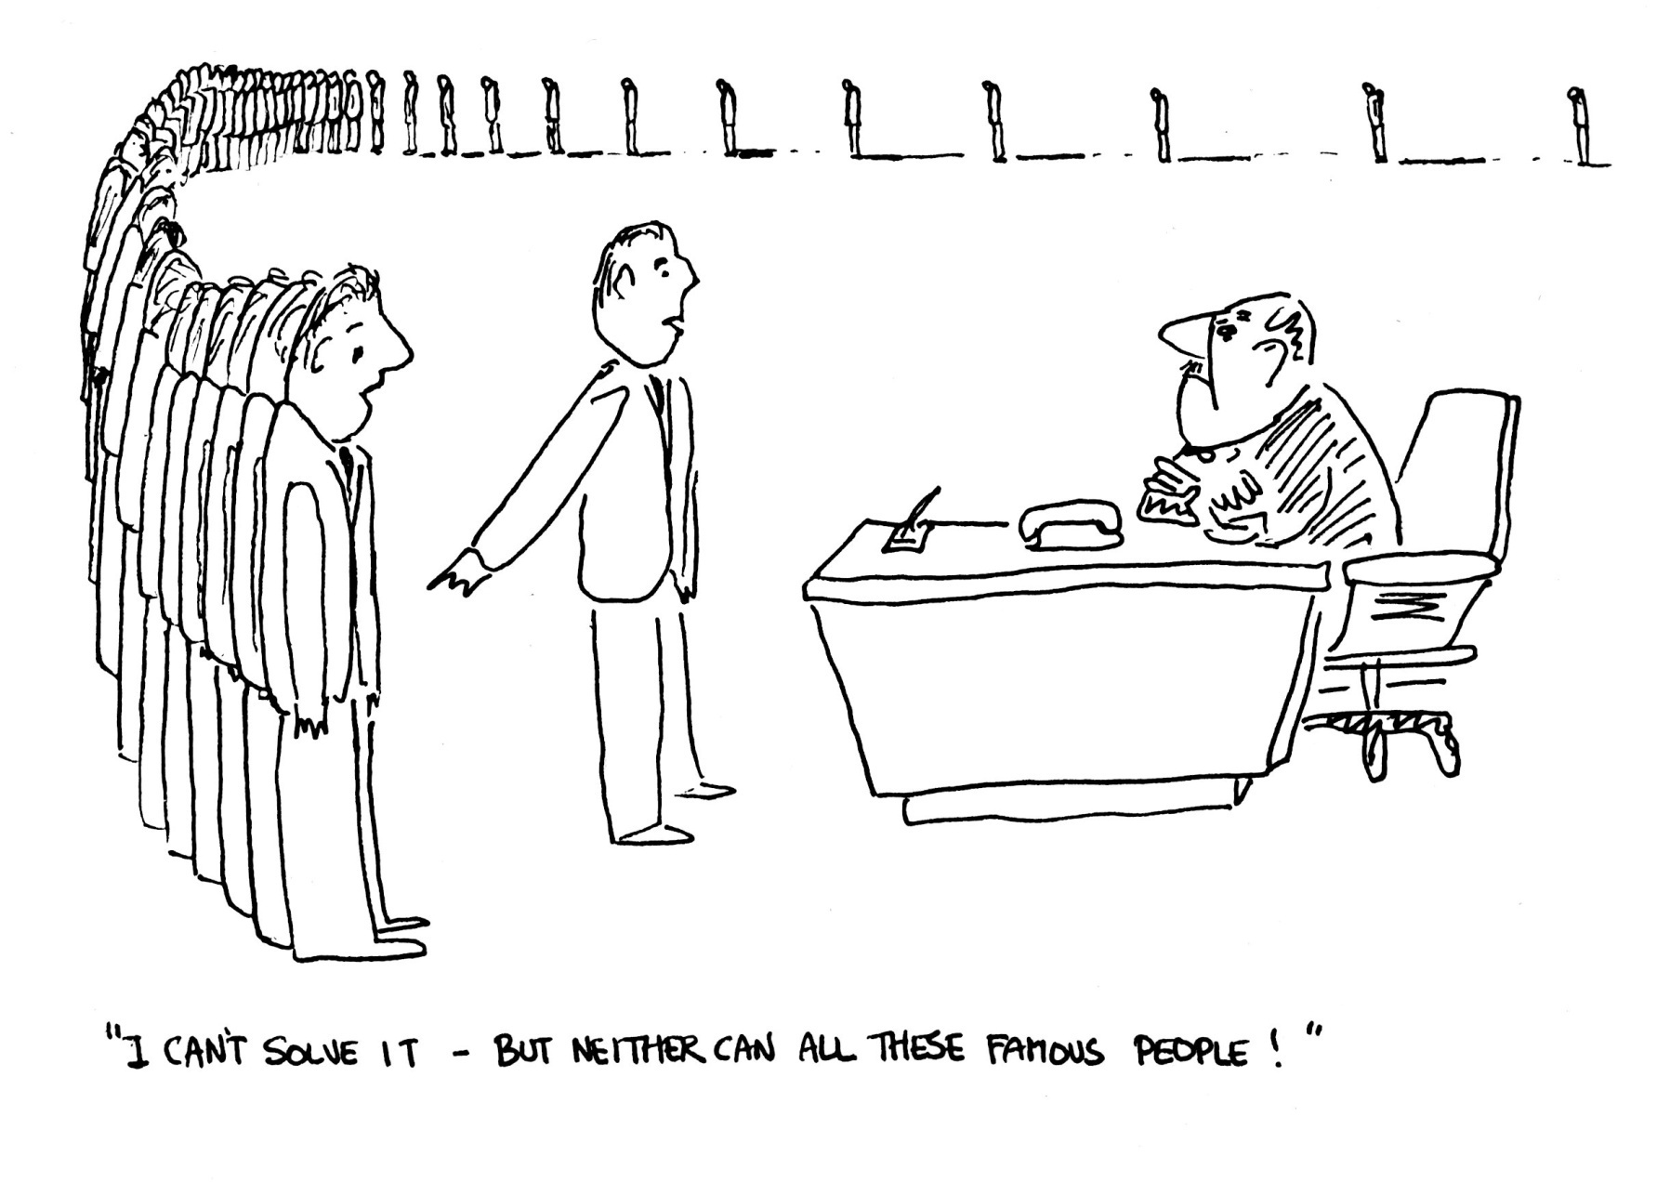

Slide 29
Try every possibility ：(n-1)! possibilities grows faster than exponentially
If it took 1 microsecond to calculate each possibility
takes 10¹⁴⁰ centuries to calculate all possibilities when n = 100.

Slide 30
Solution Methods
Try every possibility (n-1)! possibilities – grows faster than exponentially
If it took 1 microsecond to calculate each possibility
takes 10¹⁴⁰ centuries to calculate all possibilities when n = 100
Optimising Methods obtain guaranteed optimal solution, but can take a very, very, long time
III. Heuristic Methods obtain ‘good’ solutions ‘quickly’ by intuitive methods.
No guarantee of optimality
(Place problem in newspaper with cash prize)

Slide 31
The Nearest Neighbour Method (Heuristic)
– A ‘Greedy’ Method
Start Anywhere
Go to Nearest Unvisited City
Continue until all Cities visited
Return to Beginning

Slide 32
A 42-City Problem The Nearest Neighbour Method (Starting at City 1)
5
25
8
31
37
24
6
28
32
36
41
26
30
14
27
11
15
7
23
9
40
33
22
29
12
13
2
19
34
35
42
20
16
38
17
4
21
10
3
1
39
18

Slide 33
The Nearest Neighbour Method (Starting at City 1)
5
25
8
31
37
24
6
28
32
36
41
26
30
14
27
11
15
7
23
9
40
33
22
29
12
13
2
19
34
35
42
20
16
38
17
4
21
10
3
1
39
18

Slide 34
The Nearest Neighbour Method (Starting at City 1) Length 1498
5
25
8
31
37
24
6
28
32
36
41
26
30
14
27
11
15
7
23
9
40
33
22
29
12
13
2
19
34
35
42
20
16
38
17
4
21
10
3
1
39
18

Slide 35
Remove Crossovers
5
25
8
31
37
24
6
28
32
36
41
26
30
14
27
11
7
15
23
40
33
9
22
29
12
13
2
19
34
35
42
20
16
38
17
4
21
10
3
1
39
18

Slide 36
Remove Crossovers
5
25
8
31
37
24
6
28
32
36
41
26
30
14
27
11
7
15
23
40
33
9
22
29
12
13
2
19
34
35
42
20
16
38
17
4
21
10
3
1
39
18

Slide 37
Remove Crossovers Length 1453
5
25
8
31
37
24
6
28
32
36
41
26
30
14
27
11
7
15
23
40
33
9
22
29
12
13
2
19
34
35
42
20
16
38
17
4
21
10
3
1
39
18

Slide 38
Christofides Method (Heuristic)
Create Minimum Cost Spanning Tree (Greedy Algorithm)
‘Match’ Odd Degree Nodes
Create an Eulerian Tour - Short circuit
cities revisited

Slide 39
Christofides Method 42 – City Problem
Minimum Cost Spanning Tree
5
8
Length 1124
25
31
24
37
6
28
26
30
32
36
27
41
14
11
23
7
33
15
22
9
40
29
12
13
2
35
19
34
42
38
20
16
17
4
21
10
3
39
18
1

Slide 40
Minimum Cost Spanning Tree by Greedy Algorithm
Match Odd Degree Nodes

Slide 41
Match Odd Degree Nodes in Cheapest Way – Matching Problem
5
5
8
8
25
25
31
31
37
24
37
24
6
6
28
28
30
30
36
26
36
26
32
32
27
27
11
41
11
41
14
14
23
23
7
7
33
33
22
15
22
15
9
9
29
40
29
40
12
12
2
13
2
13
35
35
19
19
34
42
34
42
38
20
38
20
16
16
21
21
10
17
10
17
4
4
3
3
39
39
1
18
1
18

Slide 42
Create Minimum Cost Spanning Tree (Greedy Algorithm)
‘Match’ Odd Degree Nodes
Create an Eulerian Tour - Short circuit
cities revisited

Slide 43
Create a Eulerian Tour – Short Circuiting Cities revisited
Length 1436
5
8
25
31
37
24
6
28
36
32
41
26
27
30
14
11
7
15
23
40
33
9
22
29
12
13
2
19
34
42
35
20
16
38
17
4
21
10
3
1
39
18

Slide 44
Optimising Method
Make sure every city visited once and left once – in cheapest way (Easy)
-The Assignment Problem - Results in subtours Length 1098
5
8
25
31
37
24
6
28
36
32
41
26
30
14
27
11
7
15
23
40
33
9
22
29
12
13
2
19
42
34
35
20
16
38
17
4
21
10
3
1
39
18

Slide 45
Put in extra constraints to remove subtours (More Difficult)
Results in new subtours Length 1154
5
8
25
31
37
24
6
28
36
41
32
14
26
30
27
7
11
15
23
40
33
9
22
29
12
13
2
19
34
42
35
20
16
38
17
4
21
10
3
1
39
18

Slide 46
Remove new subtours
Results in further subtours Length 1179
5
8
25
31
37
24
6
28
36
32
41
26
30
14
27
11
7
15
23
40
33
9
22
29
12
13
2
19
42
34
35
20
16
38
17
4
21
10
3
1
39
18

Slide 47
Further subtours Length 1189
5
8
25
31
37
24
6
28
36
32
41
26
30
14
27
11
7
15
23
40
33
9
22
29
12
13
2
19
42
34
35
20
16
38
17
4
21
10
3
1
39
18

Slide 48
Further subtours Length 1192
5
8
25
31
37
24
6
28
32
36
41
26
30
14
27
11
7
15
23
40
33
9
22
29
12
13
2
19
42
34
35
16
20
38
17
4
21
10
3
1
39
18

Slide 49
Further subtours Length 1193
5
8
25
31
37
24
6
28
32
36
41
26
30
14
27
7
11
15
23
40
33
9
22
29
12
13
2
19
42
34
35
20
16
38
17
4
21
10
3
1
39
18

Slide 50
Optimal Solution Length 1194
5
8
25
31
37
24
28
36
6
32
41
26
30
14
27
11
7
15
23
40
33
9
22
29
12
13
2
19
42
34
35
20
16
38
17
4
21
10
3
1
39
18

Slide 51
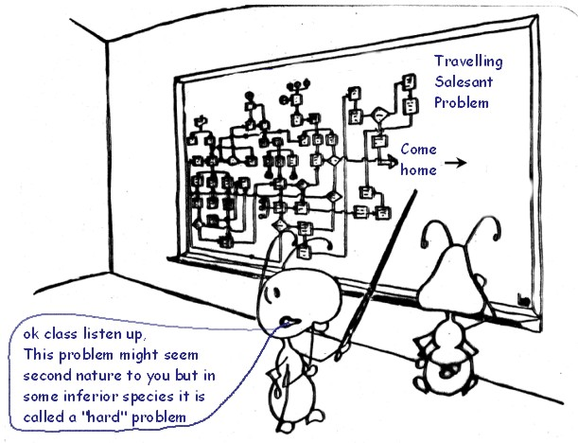

Slide 52
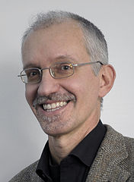
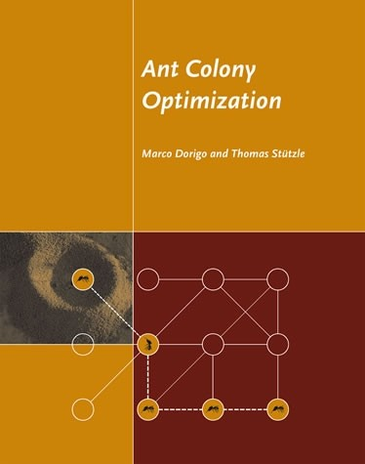
Ant Colony Optimization
The attempt to develop algorithms inspired by one aspect of ant behavior, the ability to find what computer scientists would call shortest paths, has become the field of ant colony optimization (ACO).
Marco Dorigo
By Marco Dorigo and Thomas Stützle. Ant Colony Optimization, MIT Press, 2004
M. Dorigo, Optimization, Learning and Natural Algorithms. Ph.D.Thesis, Politecnico di Milano, Italy, 1992.
E. Bonabeau, M. Dorigo & G. Theraulaz，Inspiration for
optimization from social insect behavior, Nature，2000, 406: 39–42

Slide 53
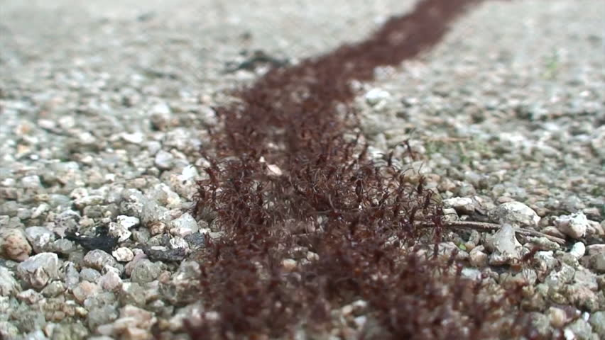
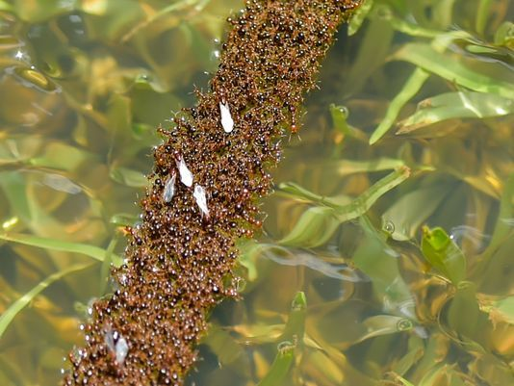

Slide 54
Natural behavior of an ant Foraging modes
Wander mode
Search mode
Return mode
Attracted mode
Trace mode
Carry mode

Slide 55
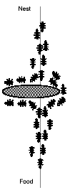
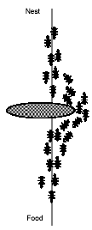
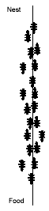
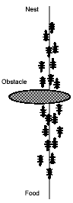
Natural behavior of ant

Slide 56
How to implement in a program
Ants: Simple computer agents
Move ant: Pick next component in the construction of solution
Trace: Pheromone, , a global type of information
Memory: M_{K} or Tabu_{K}
Next move: Use probability to move ant

Slide 57
Ant Colony Optimization (ACO) for TSP
Graph (N,E): where N = cities(nodes), E = edges
= the tour cost from city i to city j (edge weight)
Ant move from one city i to the next j with some transition probability.
B
A
D
C

Slide 58
Ant Colony Optimization (ACO) for TSP
Each edge is associated a static value based on the edge-cost η(r,s) = 1/d_{r,s}.
Each edge of the graph is augmented with a trace τ(r,s) deposited by ants. Initially, 0.
Trace is dynamic and it is learned at run-time
Each ant tries to produce a complete tour, using the probability depending on η(r,s) and τ(r,s) to choose the next city.

Slide 59
Initialize
Place each ant in a randomly chosen city
For Each Ant
Choose NextCity(For Each Ant)
yes
more cities
to visit
No
Return to the initial cities
Update trace level using the tour cost for each ant
No
Stopping
criteria
yes
Print Best tour

Slide 60

A simple TSP example
[]
1
[]
A
B
2
[]
C
3
[]
4
D
E
[]
d_{AB} =100;d_{BC} = 60…;d_{DE} =150
5

Slide 61
Iteration 1
[A]
[B]
1
A
2
B
[C]
3
C
[D]
[E]
D
5
4
E

Slide 62
How to choose next city?
[A]
1
A
B
[A]
1
[A]
C
1
[A,D]
[A]
1
1
D
E

Slide 63
Iteration 2
[E,A]
[C,B]
5
A
3
B
[B,C]
2
C
[A,D]
[D,E]
1
D
4
E

Slide 64
Iteration 3
[D,E,A]
[E,A,B]
4
5
A
B
[A,D,C]
1
C
[B,C,D]
[C,B,E]
2
D
3
E

Slide 65
Iteration 4
[B,C,D,A]
[D,E,A,B]
2
A
4
B
[E,A,B,C]
5
C
[C,B,E,D]
[A,DCE]
D
3
1
E

Slide 66
Iteration 5
[C,B,E,D,A]
[A,D,C,E,B]
3
1
A
B
[D,E,A,B,C]
4
C
[E,A,B,C,D]
[B,C,D,A,E]
D
5
E
2

Slide 67
Path and Trace Update
[A,D,C,E,B]
L₁ =300
1
[B,C,D,A,E]
L₂ =450
2
[C,B,E,D,A]
L₃ =260
3
[D,E,A,B,C]
L₄ =280
4
[E,A,B,C,D]
L₅ =420
5

Slide 68
Ant System (Ant Cycle) Dorigo [1] 1991
t = 0; NC = 0; τ_{ij}(t)=c for ∆τ_{ij}=0
Place the m ants on the n nodes
Initialize
Update tabu_{k}(s)
Tabu list management
Choose the city j to move to. Use probability
Move k-th ant to town j. Insert town j in tabu_{k}(s)
Compute the length L_{k} of every ant
Update the shortest tour found
=
For every edge (i,j)
Compute
For k:=1 to m do
Yes
NC<NC_{max}
&& !stagn.
No
Set t = t + n; NC=NC+1; ∆τ_{ij}=0
End

Slide 69
Performance
• Algorithm found best solutions on small problems
(75 city)
• On larger problems converged to good solutions –
but not the best
• On “static” problems like TSP hard to beat specialist algorithms
• Ants are “dynamic” optimizers – should we even
expect good performance on static problems
• Coupling ant with local optimizers gave world
class results….

Slide 70
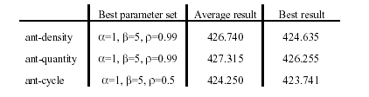
Parameters of ACO
Comparison among three strategies, averages over 10 trials.
Other parameters: Q, constant for trace updates, and
m, the number of ants
Taken from Dorigo [1]

Slide 71
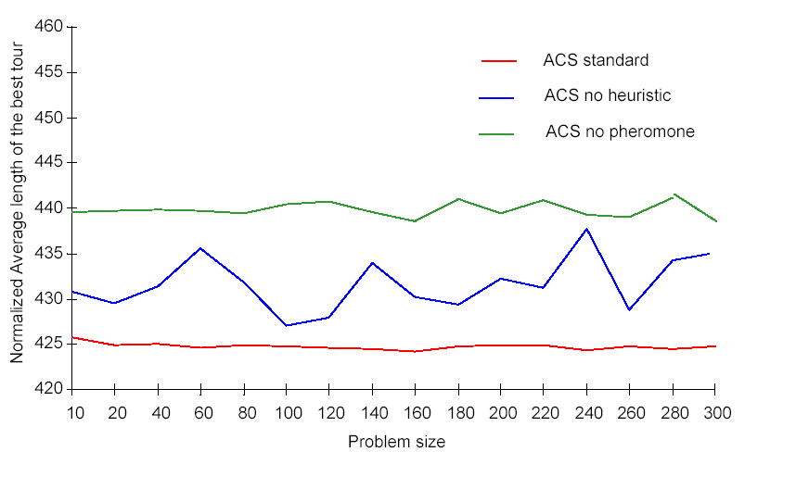
Pheromone trail and heuristic function:
are they useful?
Comparison between ACS standard, ACS with no heuristic (i.e., we set B=0), and ACS in which ants
neither sense nor deposit pheromone. Problem: Oliver30. Averaged over 30 trials, 10,000/m iterations per trial.

Slide 72
ACO Algorithms
Elitist Ant System (EAS)
Rank-Based Ant System (AS_{rank})
Min-Max Ant System (MMAS)
Ant Colony System (ACS)
Approximate Nondeterministic Tree Search (ANTS)
Hyper-Cube Framework for ACO

Slide 73
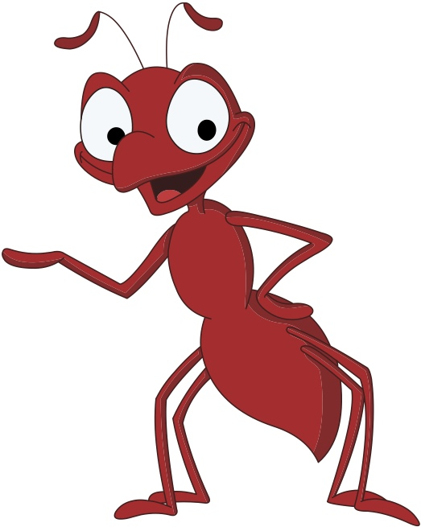
Elitist Ant System
First improvement on AS.
Best-so-far ant deposits pheromone on each iteration:
M.Dorigo, V. Maniezzo and A. Colorni, Ant System: Optimization by a colony of cooperating agents, IEEE Transactions on Systems, Man, and Cybernetics-Part B, 26(1), 29-41, 1996

Slide 74
Rank-based Ant System
Rank all ants
Each ant deposits amounts of pheromone proportional to its rank
B. Bullnheimer, R. F. Hartl and C. Strauss, A New Rank Based Version of the Ant System: A Computational Study. Central European Journal for Operations Research and Economics, 7(1):25-38, 1999

Slide 75
Ant Colony System
Differs from Ant System in three points:
More aggressive tour construction rule
Only best ant evaporates and deposits pheromone
Local pheromone update
M. Dorigo & L.M. Gambardella, Ant Colony System: A Cooperative Learning Approach to the Traveling Salesman Problem. IEEE Transactions on Evolutionary Computation, 1(1):53-66,1997.

Slide 76
MAX-MIN Ant System
Only iteration-best or best-so-far ant deposits pheromone
Pheromone trails are limited to the interval [τ_{min,} τ_{max}]
T. Stützle and H. H. Hoos, MAX-MIN Ant System. Future Generation Computer Systems. 16(8):889--914,2000.

Slide 77
Some inherent advantages
Positive Feedback accounts for rapid discovery of good solutions
Distributed computation avoids premature convergence
The greedy heuristic helps find acceptable solution in the early solution in the early stages of the search process.
The collective interaction of a population of agents.

Slide 78
Disadvantages in Ant Systems
Slower convergence than other heuristics
Performed poorly for TSP problems larger than 75 cities.
No centralized processor to guide the AS towards good solutions

Slide 79
Conclusion
ACO is a relatively new metaheuristic approach for solving hard combinatorial optimization problems.
Artificial ants implement a randomized construction heuristic which makes probabilistic decisions.
The cumulated search experience is taken into account by the adaptation of the pheromone trail.
ACO shows great performance with the “ill-structured” problems like network routing.
In ACO local search is important to obtain good results.

